Slide 1



Genetic architecture of type 2 diabetes
Valeriya Lyssenko, MD, PhD
University of Bergen, Norway
Diabetes and Endocrinology, Lund University Diabetes Center, Sweden
Notes:
Epidemic of diabetes led to corresponding epidemic of complications.

Slide 2
Mode of onset of diabetes
Pattern A
Pattern B
200
180
160
140
120
100
80
Diabetes
Fasting plasma glucose
(mg/dl)
IFG
Time (years)
Ferrannini E, et al Diabetes 2004;53:160-5

Slide 3
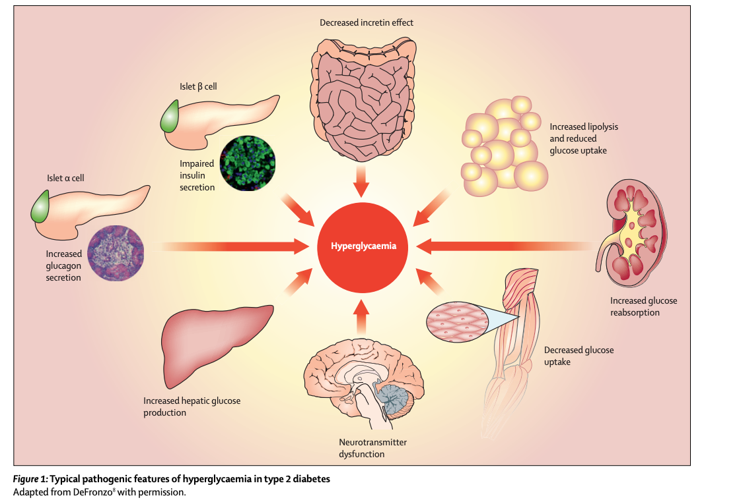
The Ominous Octet
Solis-Herrera C, .. DeFronzo 2021

Slide 4

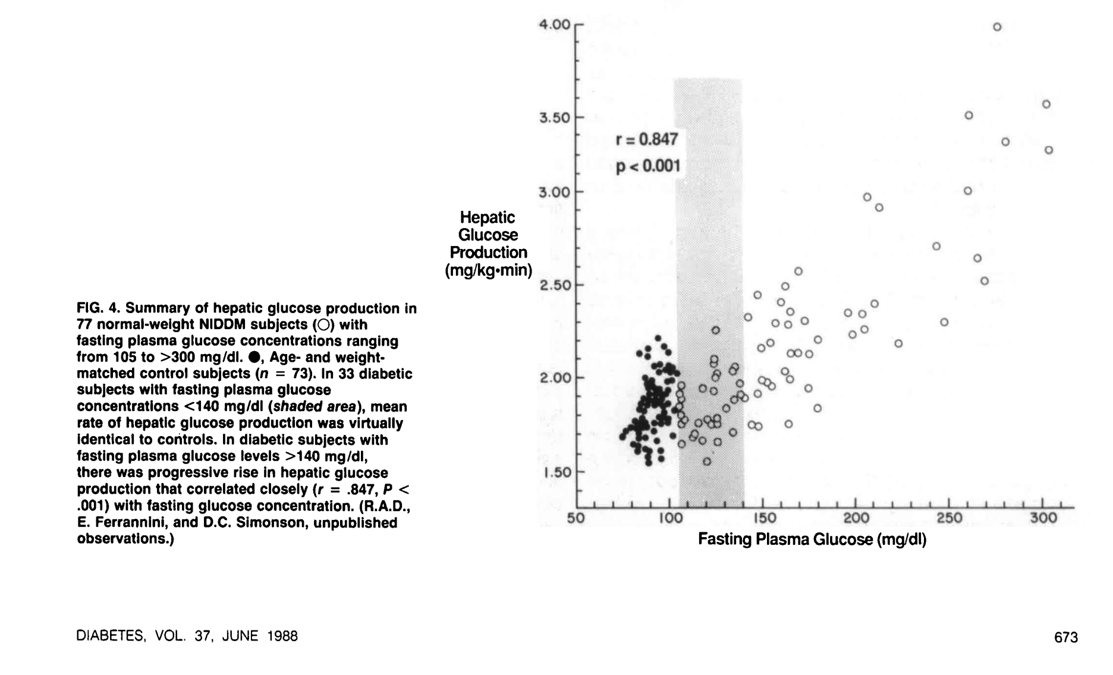
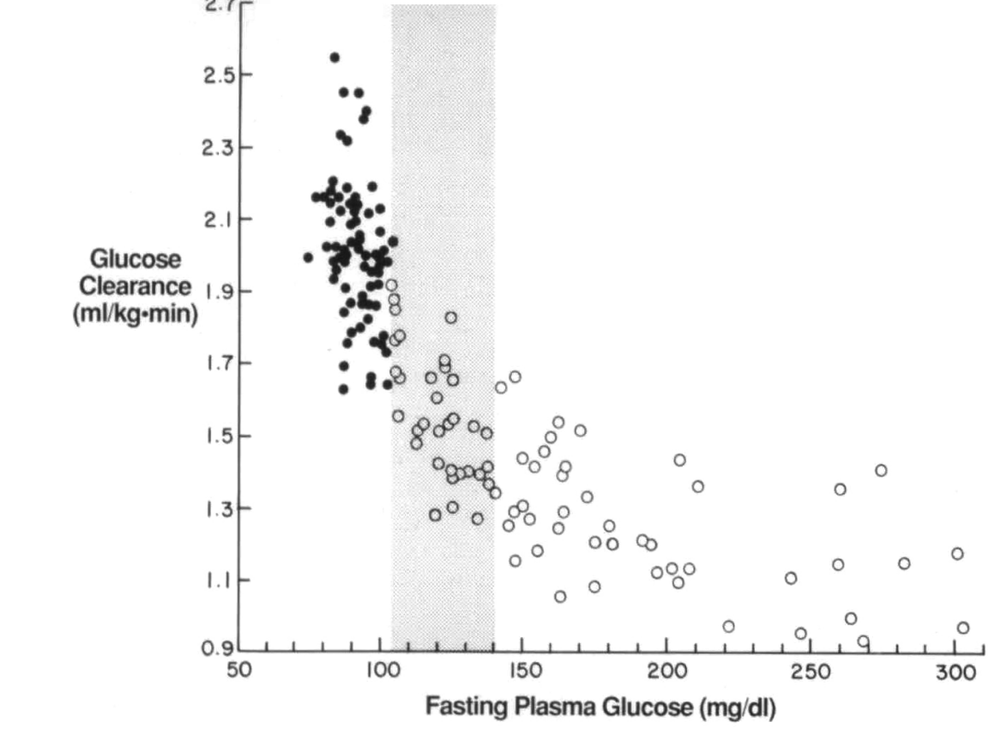
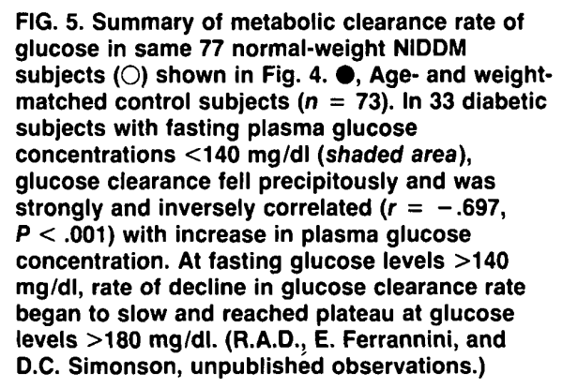

Slide 5
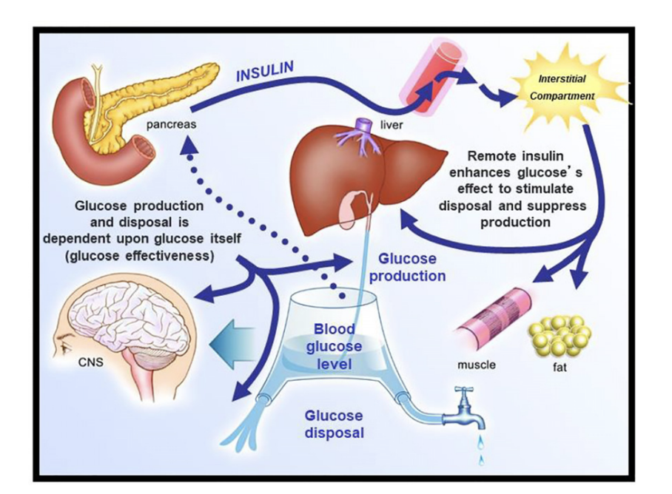
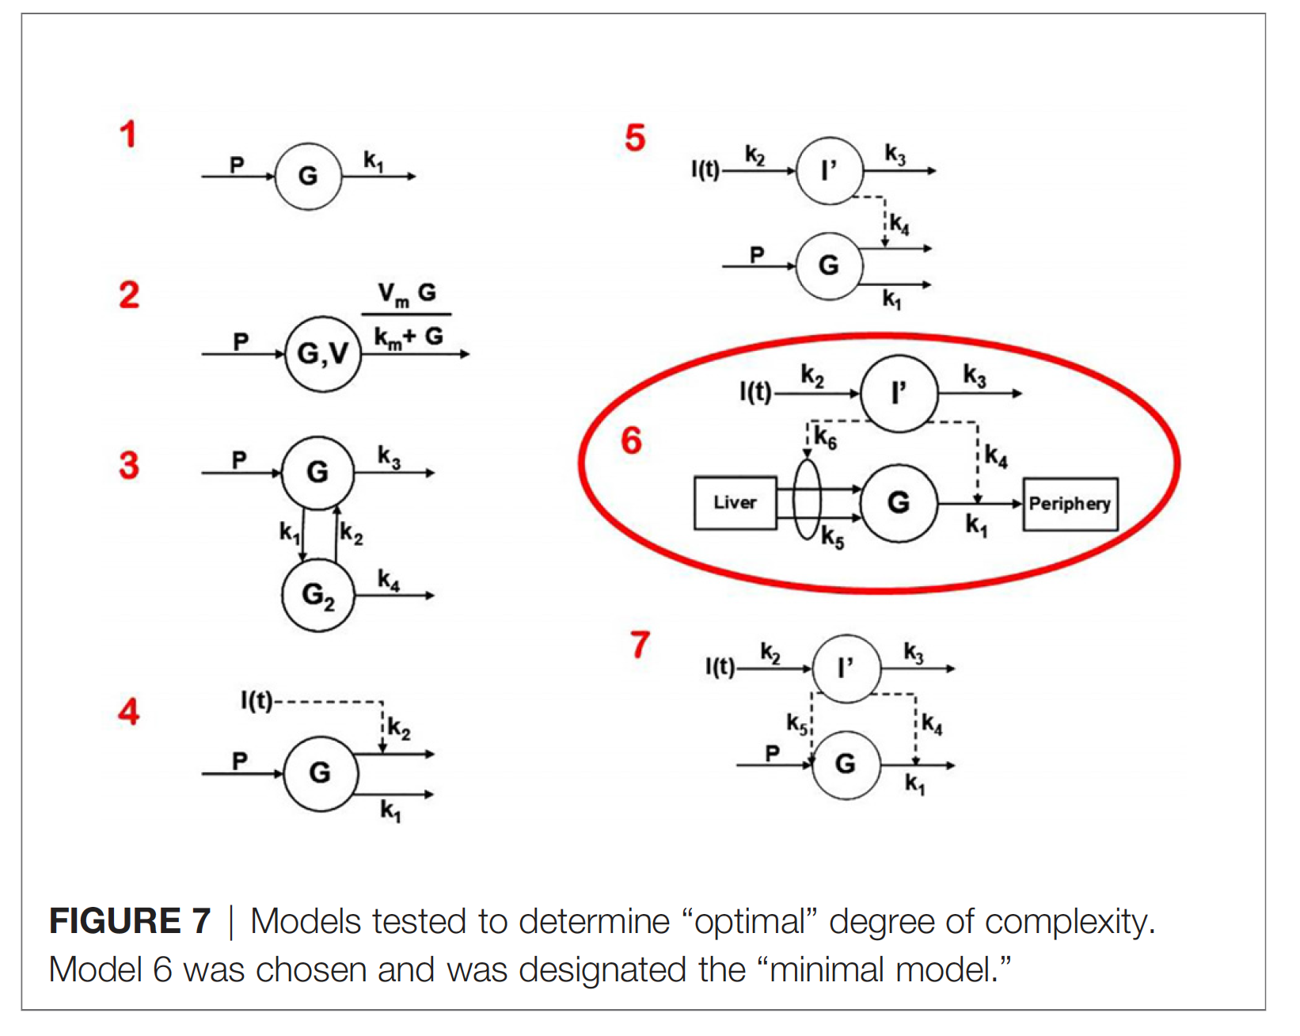
The culprit – close loop system of glucose regulation
Richard N Bergman. Origins and History of the Minimal Model of Glucose Regulation. Frontiers Endocrinology, 2021

Slide 6

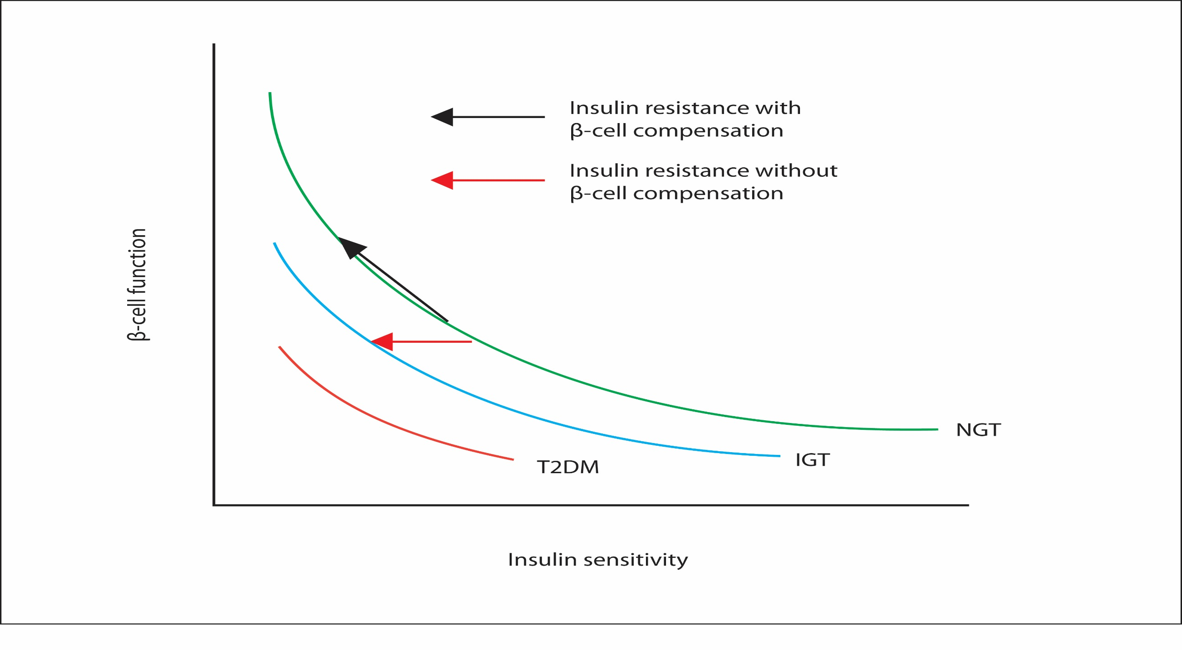



Beta-cell function, environment and genes
Hyperinsulinemic compensation
Genes ?
Insulin sensitivity ⨯ b-cell function = disposition index
Obesity, pregnancy, puberty
Well-trained person

Slide 7

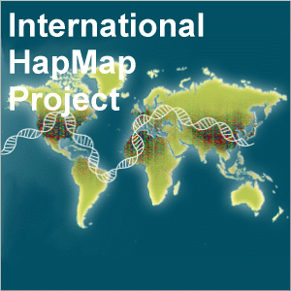
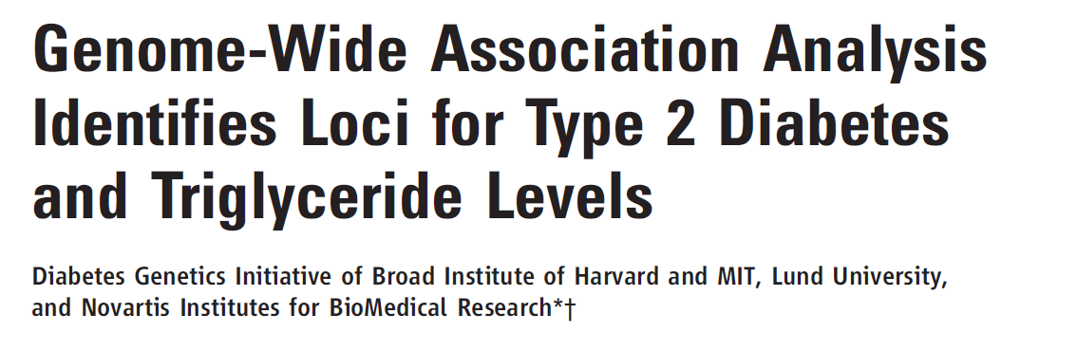
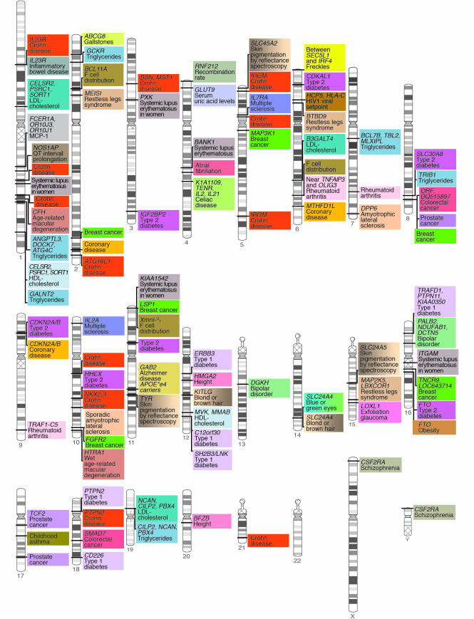

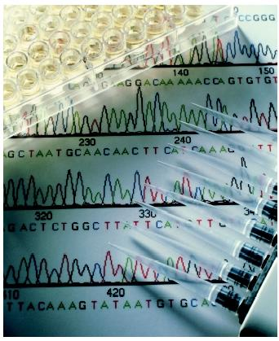
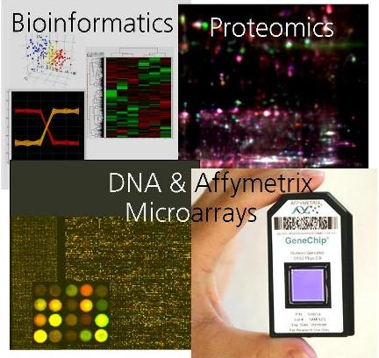
Genetic map for diabetes
Human Genome Project 2003
Saxena R, Voight B, Lyssenko V, et.al., Science, 2007
First Scandinavian 500,000 in 3000 individuals
Known genes (proteins):
～25,000
bp: 3 253 037 807
1 SNP per 1000 bp
(～5% protein coding)
Manolio et al., JCI, 2008

Slide 8
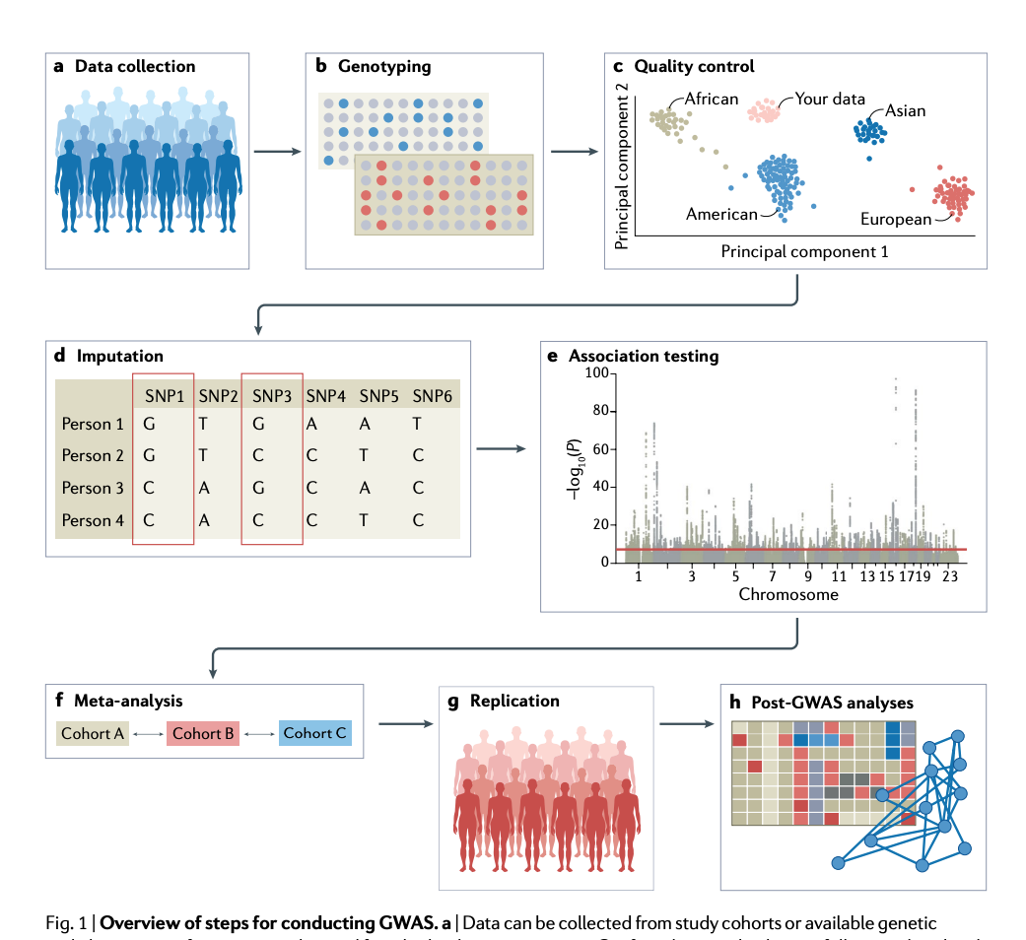
Genome-wide association study
Uffelmann et.al. Nature Reviews 2021

Slide 9
T2D polygenic risk score identified beta-cell dysfunction as the key defect in type 2 diabetes
Body Mass Index
Insulin sensitivity
Insulin secretion
Disposition index
p<0.0001
p<0.0001
Lyssenko et al, New Engl J Med 2008

Slide 10
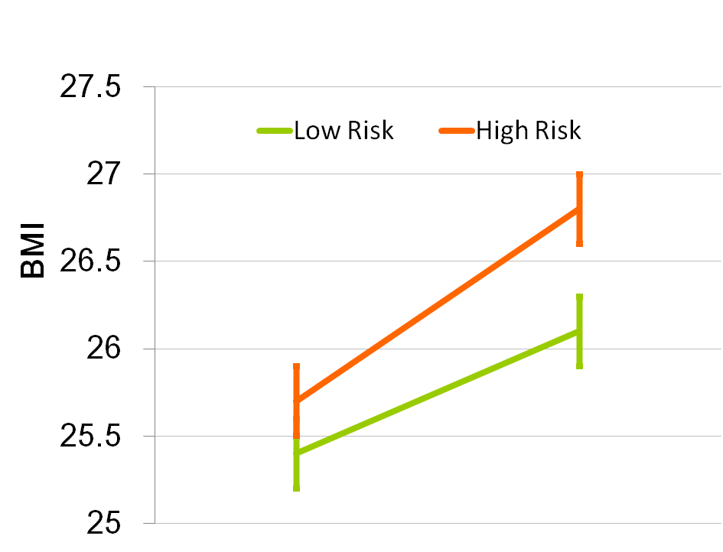
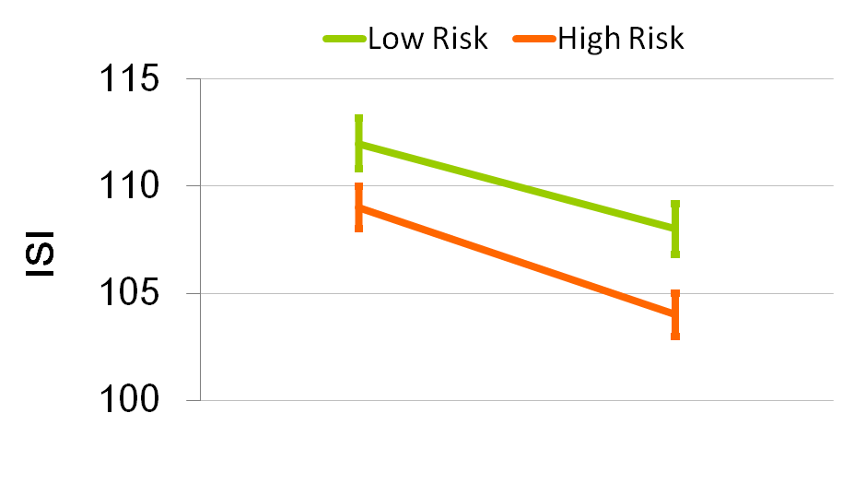
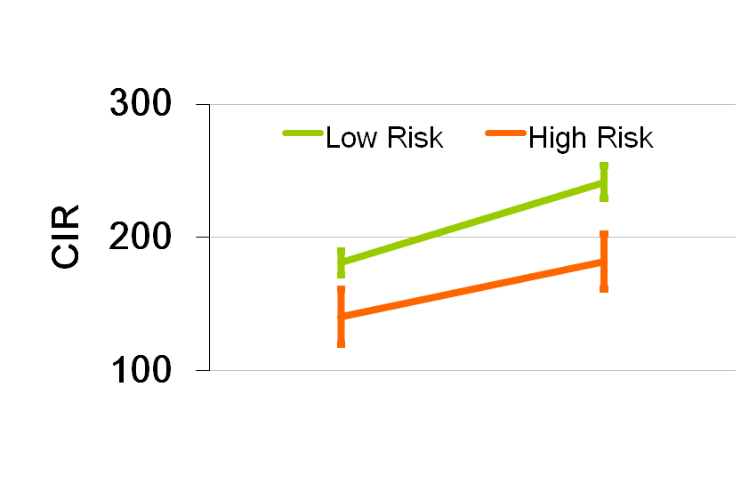
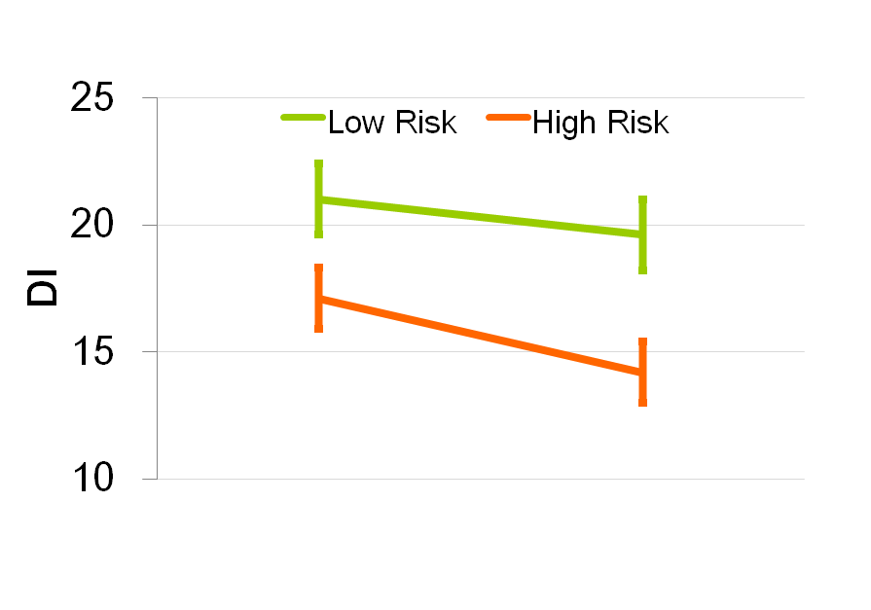
Effect of high and low risk gene scores on change in BMI, insulin secretion and action over time
Body mass index
Insulin sensitivity
*
*
**
Baseline
Follow-up
Baseline
Follow-up
Insulin secretion
Disposition index
**
**
**
**
Baseline
Follow-up
Baseline
Follow-up
High Risk Group >= 33 (17%) risk alleles
Low Risk Group <= 40 (20%) risk alleles
* P<0.05; **P<0.01

Slide 11
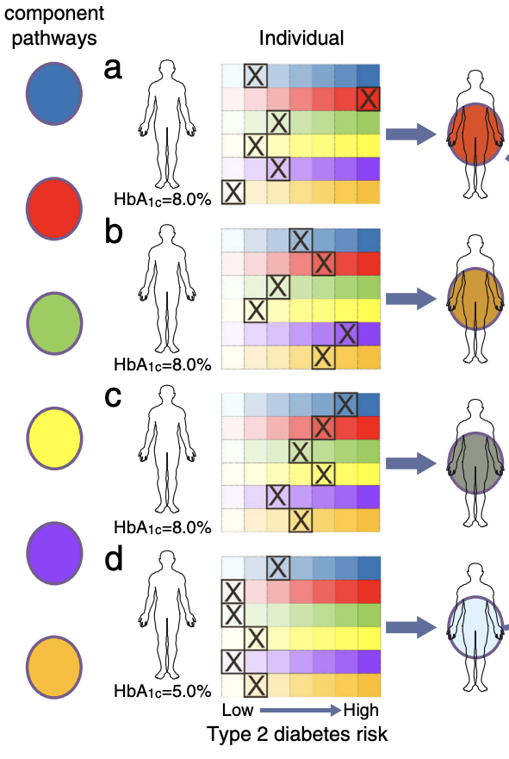
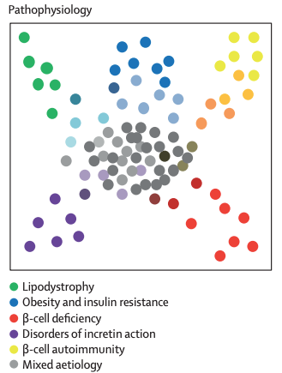
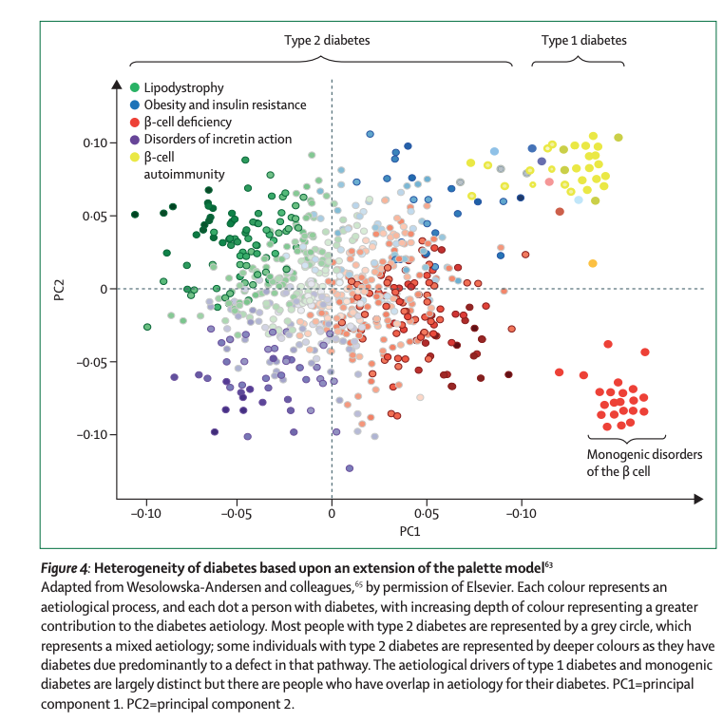
Palette model for type 2 diabetes
Mark I. McCarthy. Diabetologia 2017
Leslie et.al. Lancet Endocrin and Metab 2023

Slide 12




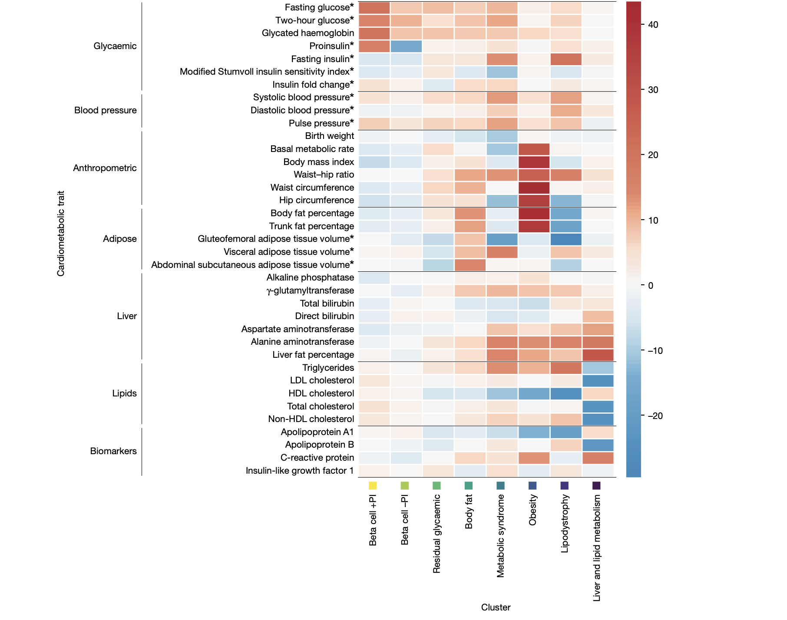
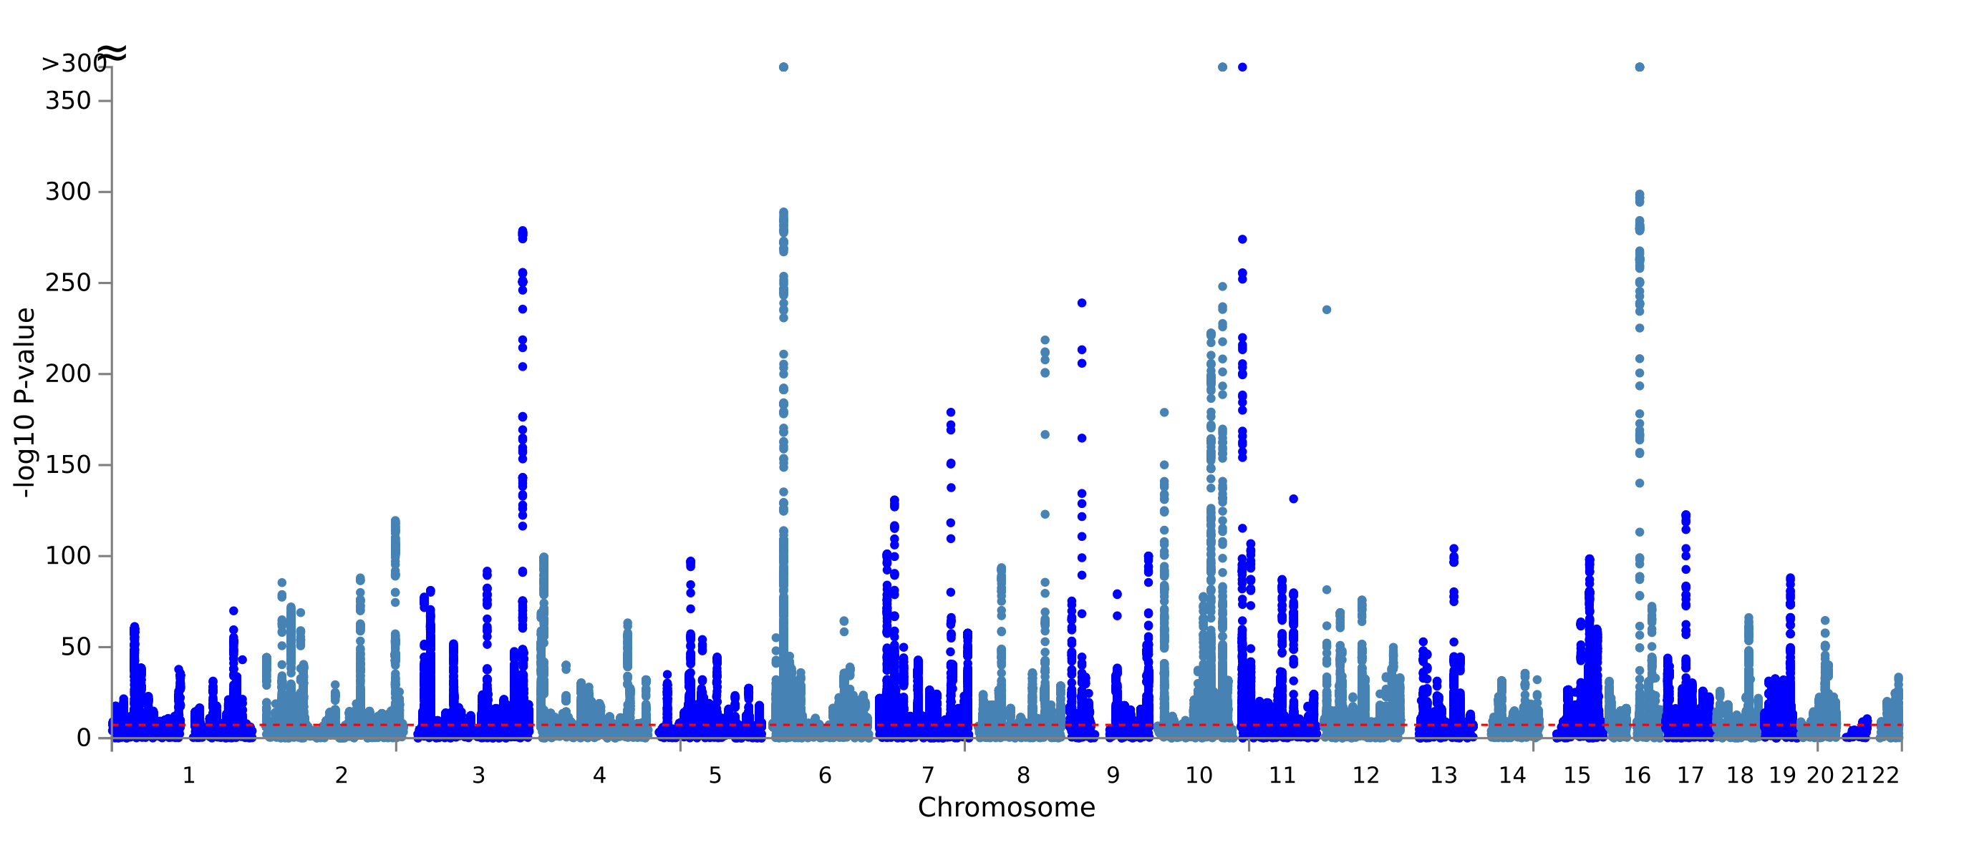
1,289 independent association signals (P<5x10⁻⁸)
611 loci, of which 145 loci are previously unreported
2,535,601 individuals (39.7% non-European ancestry), 428,452 T2D
Suzuki et.al. Nature 2024
Notes:
Cardiometabolic phenotypes used for clustering T2D SNPs

Slide 13
Cardiometabolic profile and association signals of eight mechanistic clusters
Mechanistic cluster | Cardiometabolic profile | Number of T2D loci | Exemplar loci | Physiological impact
 |  |  |  | Insulin secretion | Insulin sensitivity
Beta-cell +PI | +FG*, +2hG*, +HbA1c, +PI* | 91 | TCF7L2, KCNQ1, CDKAL1, CDKN2A-CDKN2B, SLC30A8 | - | +
Beta-cell -PI | +FG*, +2hG*, +HbA1c, -PI* | 89 | CDC123-CAMK1D, HNF1B, KCNJ11-ABCC8, HNF4A, HNF1A | - | +
Impaired FG | +FG*, +HbA1c | 389 | GCC1-PAX4-LEP, ANKRD55, GCKR, UBE2E2 | - | -
Body fat | +body fat, +ASAT* | 273 | ZMIZ1, HMGA2, CTBP1 | + | -
Metabolic syndrome | +FG*, +FI*, +WHR, +VAT*, -GFAT*, +TG, -HDL, +BP | 166 | IGF2BP2, CCND2, HHEX-IDE, JAZF1, GPSM1 | + | -
Obesity | +BMI, +WHR, +body fat, +BMR, +TG, -HDL | 233 | FTO, MC4R, MACF1, TMEM18 | + | -
Lipodystrophy | +FI*, +WHR, -body fat, -GFAT*, +TG, -HDL, +BP | 45 | IRS1, GRB14-COBBL1, PPARG | + | -
Liver/lipid metabolism | -LDL, -TC, +liver fat, +liver biomarkers | 3 | TOMM40-APOE-GIPR, TM6SF2, PNPLA3 | - | -

Slide 14
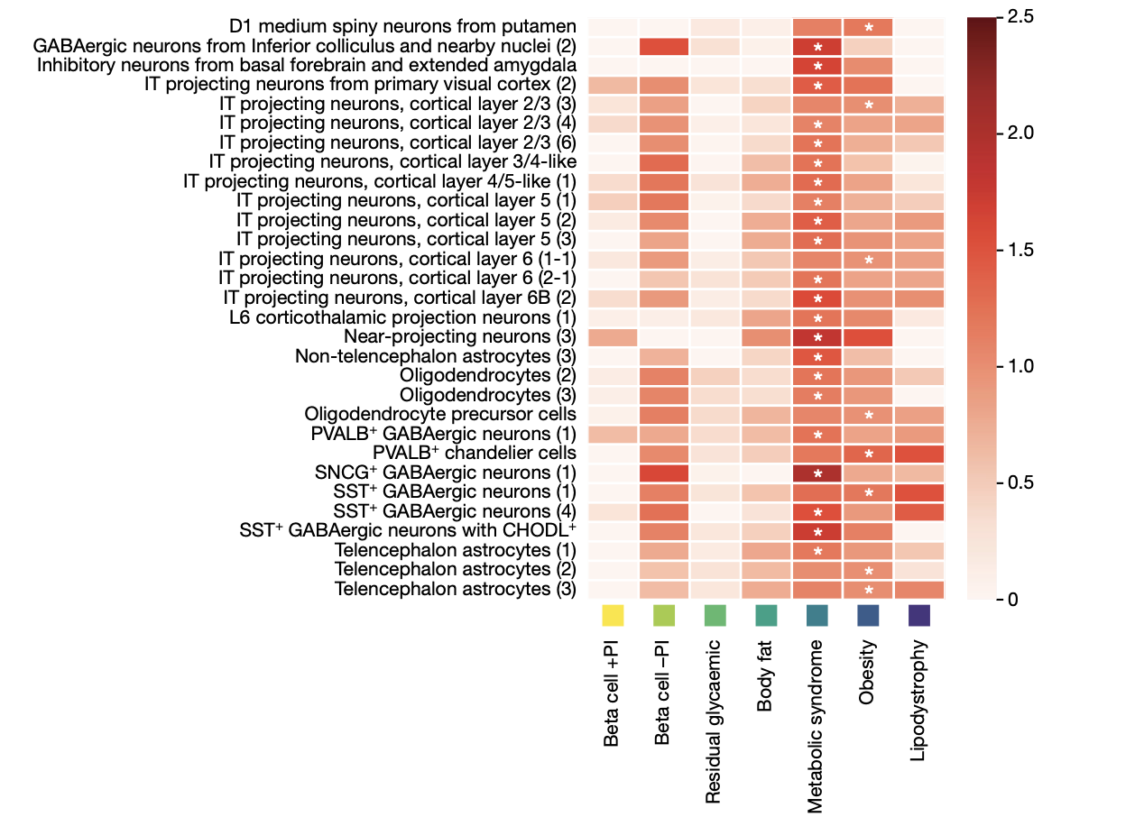
Enrichment of neuronal signals in human brain in obese/metabolic syndrome and low proinsulin clusters

Slide 15
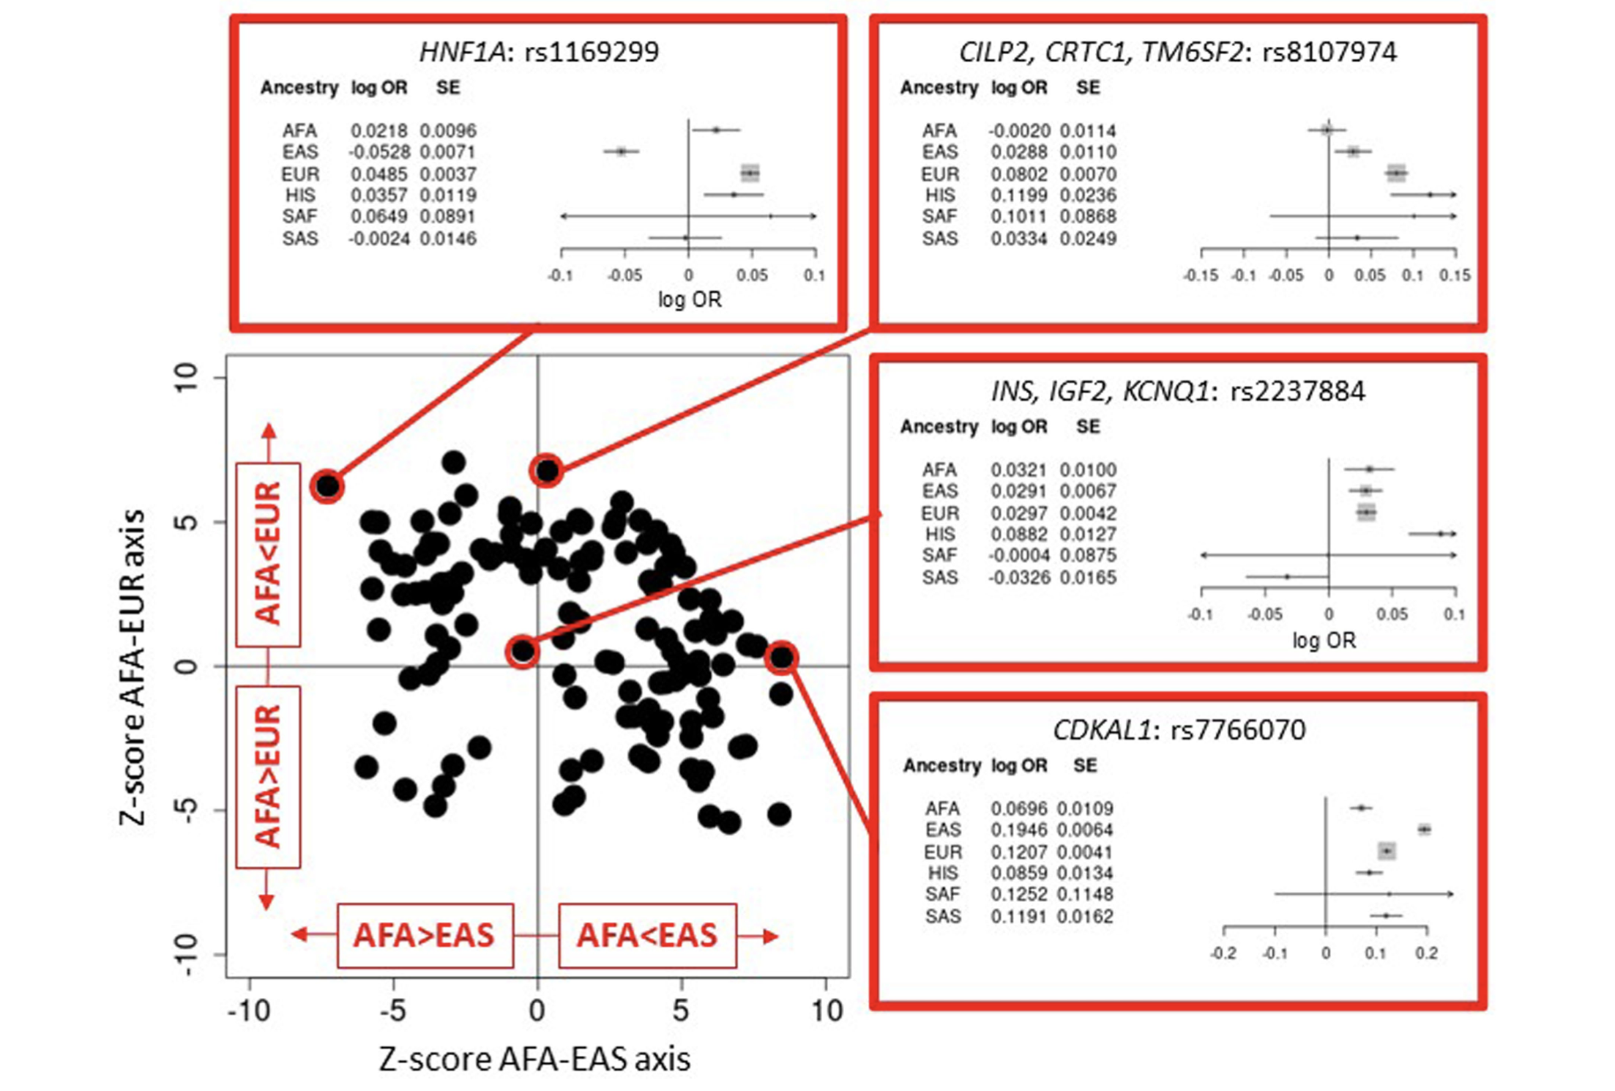

Genetic allelic effects are different in size between the ancestries

Slide 16
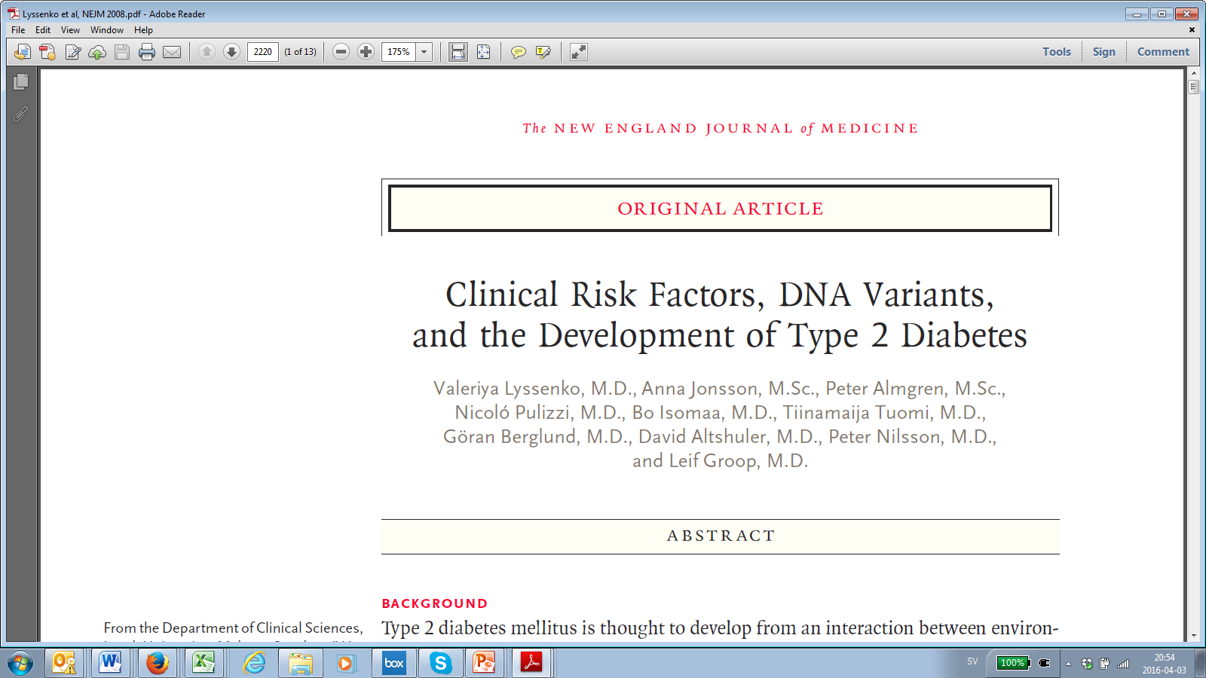
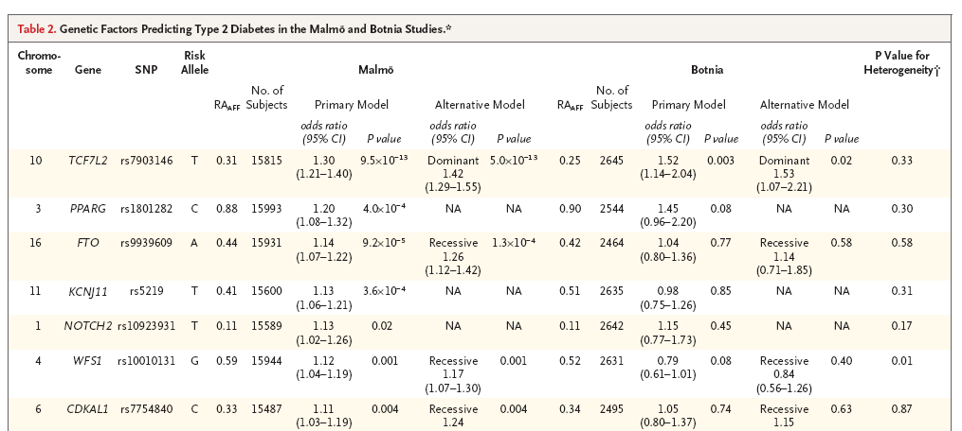
10 TCF7L2 T 0.31 1.30 9.5×10⁻¹³ 1.52 0.003
16 genetic markers tested to predict diabetes in 22,000 individuals over 25-year follow-up
Lyssenko et al, N Engl J Med , 2008
Notes:
This slide shows the progress that has been made in discovering loci for type 2 diabetes. The majority of loci were discovered using the GWAS approach. Later this year, we should see at least another 12 type 2 diabetes loci published form the DIAGRAM+ consortium, and there are now dozens of published and many more unpublished replicated loci for glycemic traits.

Slide 17
Risk genotypes in TCF7L2 are associated with impaired insulin secretion and beta-cell function
Risk of T2D
Decline in beta-cell function over time
OR=1.58
P=5×10⁻¹²
Disposition index
Malmö Preventive Project
Follow-up years
Reduced insulin secretion
P=0.005
Lyssenko et al. JCI, 2007
Notes:
The Kaplan-Meier curves for diabetes-free survival on this slide show graphically the same results I just referred to. The red line shows risk allele carriers which progressed to diabetes faster as compare to the non-risk carriers, shown in blue.
This figure also shows insulin response to glucose during OGTT. The carriers of the risk genotype (in red) had lower insulin response to glucose as compared to wild type carriers in MPP study. Moreover, most important result was that the risk carriers had faster deterioration in insulin secretion over time as compared to non-risk carriers in individuals who progressed to diabetes.

Slide 18
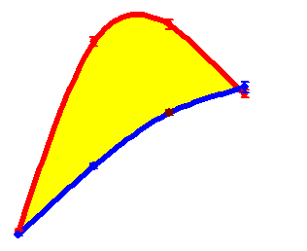
Risk genotypes in the TCF7L2 gene are associated with impaired incretin effect
Incretin effect
TCF7L2 risk carriers have lower incretin effect
Oral glucose load
Intravenous glucose load
Incretin effect = 100% x (AUCins _{OGTT}-AUCins _{IVGTT})/AUCins _{OGTT}
Lyssenko et al. JCI, 2007
Notes:
Because it was predicted that TCF7L2 would bind to preproglocagon one putative effect could be that it would influence the enteroinsulilar axis or the increatin effect which would mean that we have a greater response to oral than to intraveneous glucose tolerance test due to the excess of gut hormones like GLP1 and GIP.
We compared insulin response to oral and intravenous glucose in 403 individuals with both tests to obtain a biological measure of the incretin effect. In support of a defective enteroinsular axis, there was a 20% lower insulin response to oral than to iv glucose in the risk CT/TT than in the CC genotype carriers in subjects with hyperglycemia.
This also indicated on the figure to the left hand, as the slopes of correlation between the insulin response to oral and intravenous glucose were significantly different between risk and non-risk genotype carriers.

Slide 19
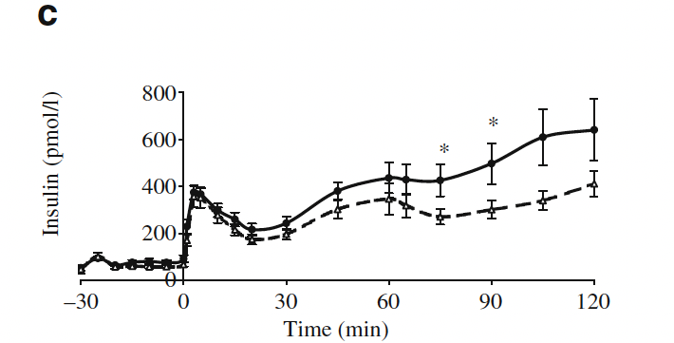
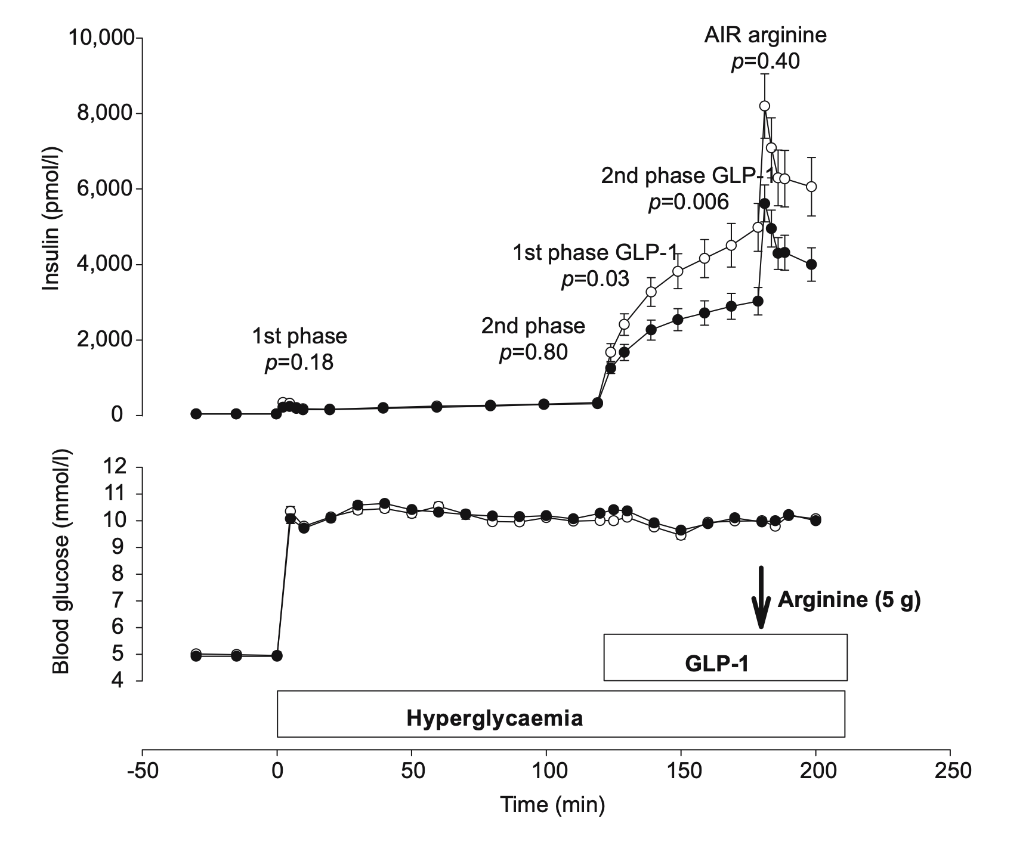
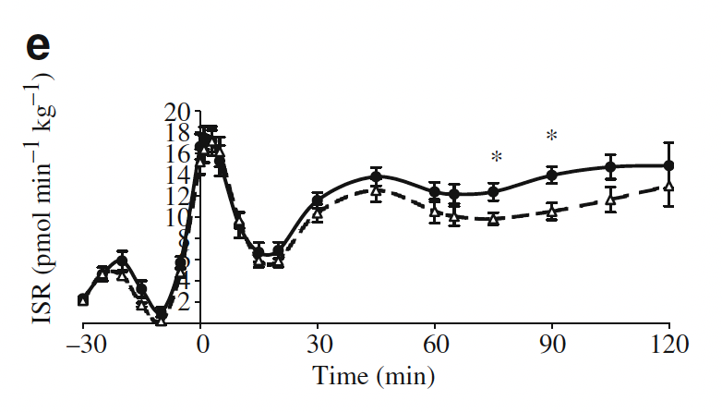
TCF7L2 risk genotypes are associated with lower incretin-stimulated insulin release
Pilgaard et al. Diabetologia. 2009, 52:1298-307
Schafer et al. Diabetologia, 2007, 50: 2443-2450.

Slide 20
TCF7L2 risk variants increase
hepatic glucose production
HGP=net release of glucose from the liver (glycogenolysis and gluconeogenesis)
36
42
EGP = endogenous glucose production
Lyssenko et al., JCI, 2007
Pilgaard et al. Diabetologia, 2009
Notes:
We also studied the effect of the variant on peripheral and hepatic insulin sensitivity. In line with other studies, we could not see an effect of TCF7L2 on peripheral insulin sensitivity assessed by euglycemic clamp.
However, rate of basal hepatic glucose production was significantly higher in carriers of the risk genotype (in red) as compared to the wild type carriers (in blue). We could replicate these results in the recent paper by Kasper Pilgaard and Allan Vaag, but also demonstrating impaired suppression of HGP during clamp.

Slide 21
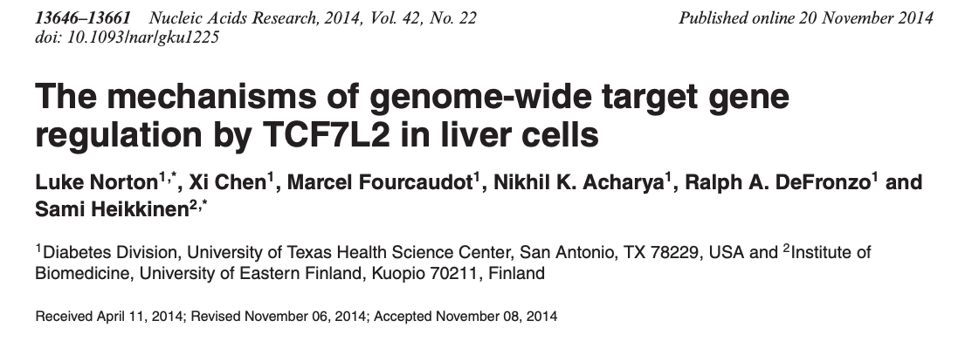
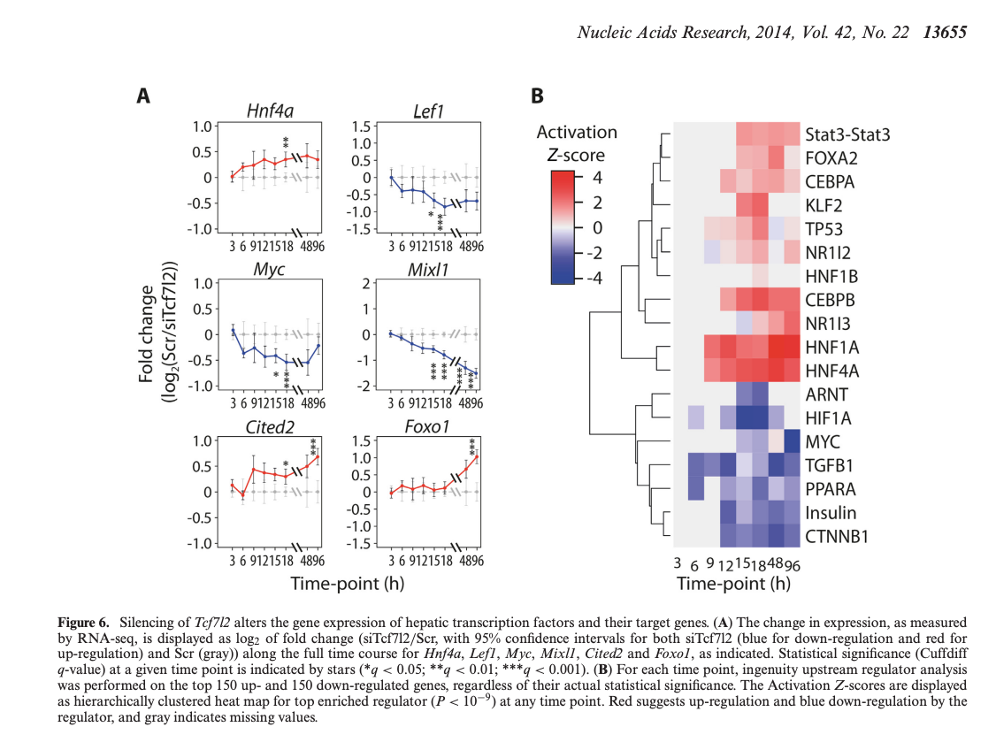

Slide 22









Diabetogenic effects of the TCF7L2
X
OFF
X
TCF7L2
Non-risk allele
ON
TCF7L2
Risk allele
Nucleosome
DNA binding motif
DNA binding protein
Gaulton et al Nat Genet 2010; Groop L. New and views Nat Genet 2010.
Notes:
- In eukaryotic cells, the activity of all DNA-templated processes, which include transcription, recombination, repair and replication, are controlled in part through the regulation of chromatin composition. This realization has been crucial to understanding genome function, because control of chromatin enables cells to control the use of information stored in DNA.
- Accessibility to the DNA template is mediated through differential nucleosome stability, which refers to the population of intact nucleosome-DNA complexes at a given locus relative to those in an unfolded or disrupted state.
-The mechanisms that modulate nucleosome stability can be divided into intrinsic and extrinsic mechanisms
A new study has identified a large number of open chromatin regions harboring regulatory elements in human pancreatic islets. The key SNP in the strongest type 2 diabetes associated gene thus far, TCF7L2, is located in a chromatin-free region and the risk allele increased the transcriptional activity of the gene.

Slide 23
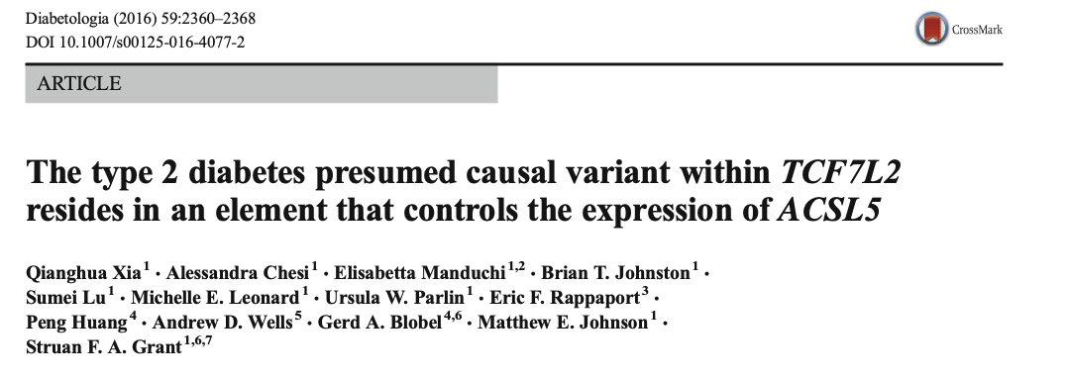
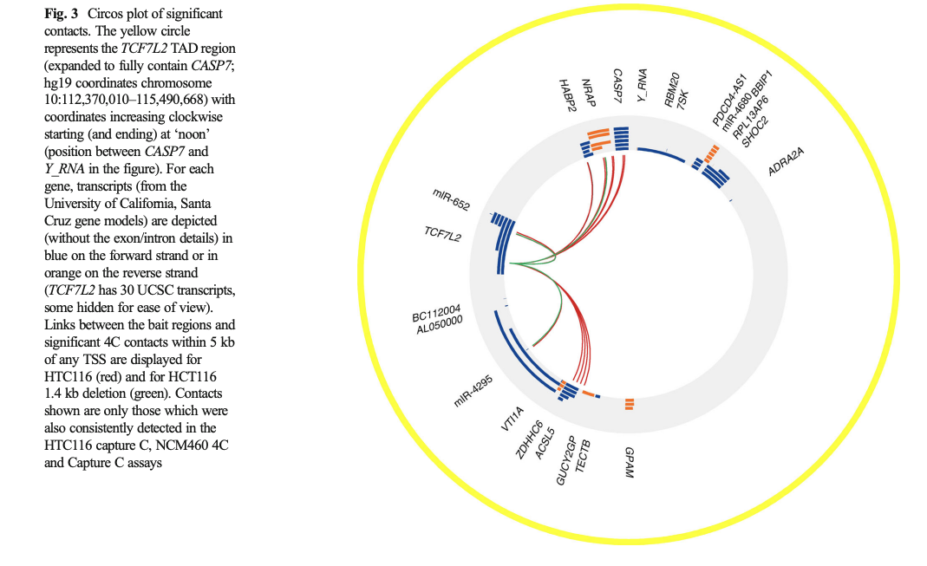
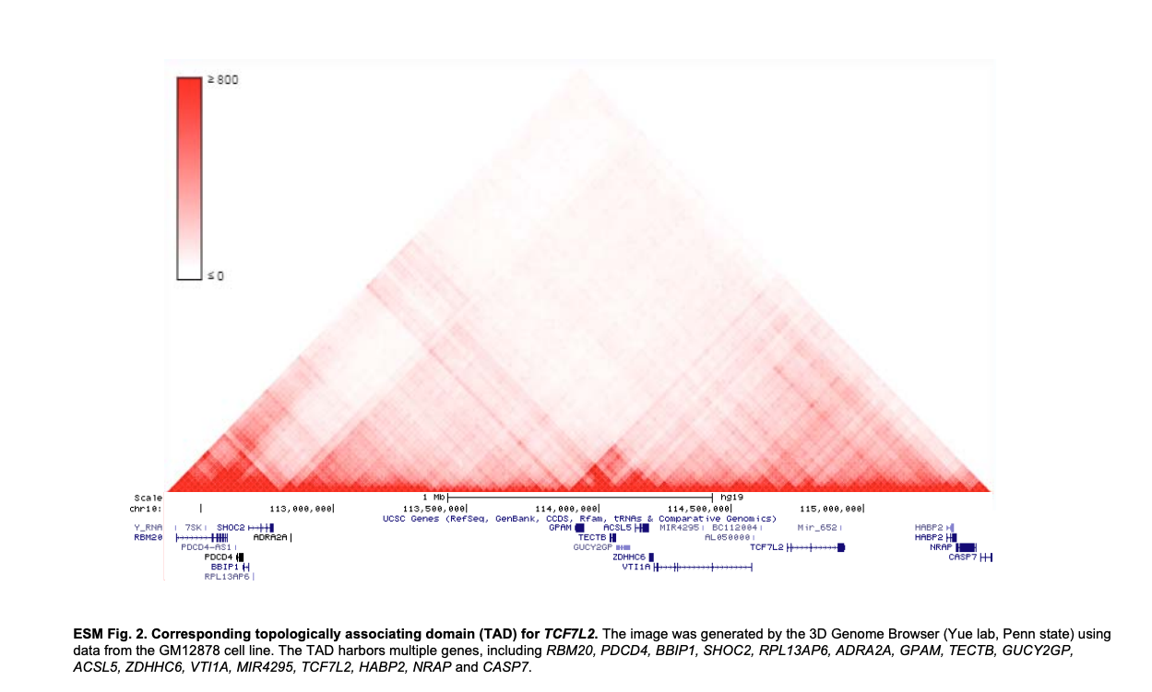
ACSL5 - Acyl-CoA synthetase long-chain family member 5

Slide 24
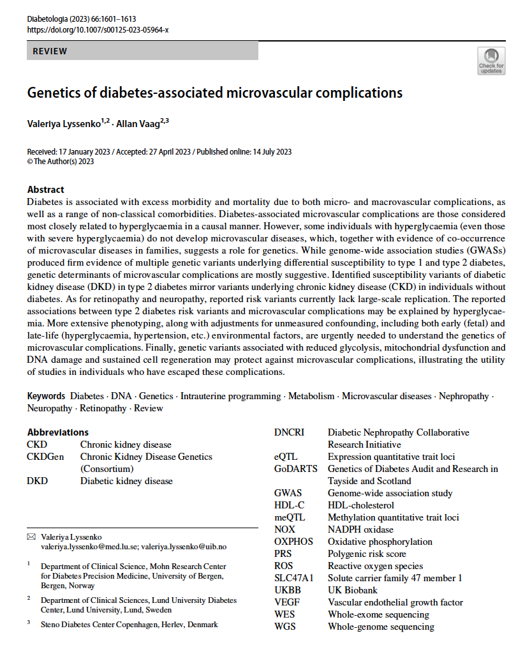
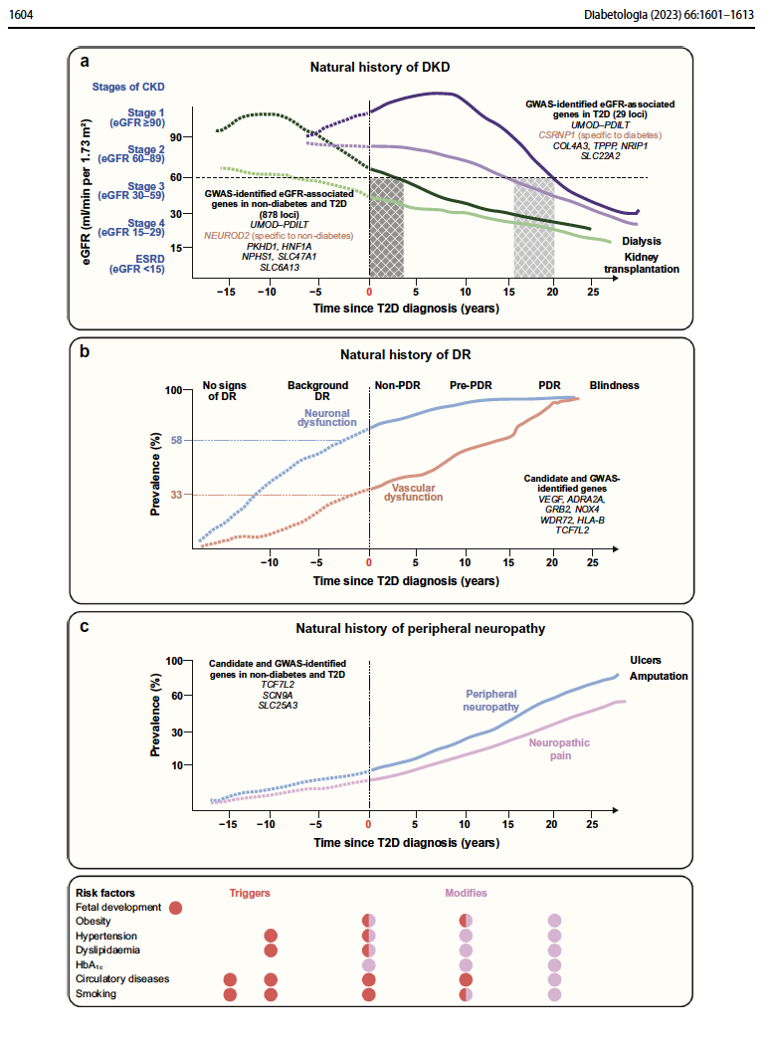
TCF7L2
TCF7L2
TCF7L2

Slide 25
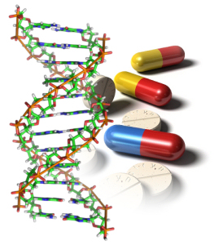
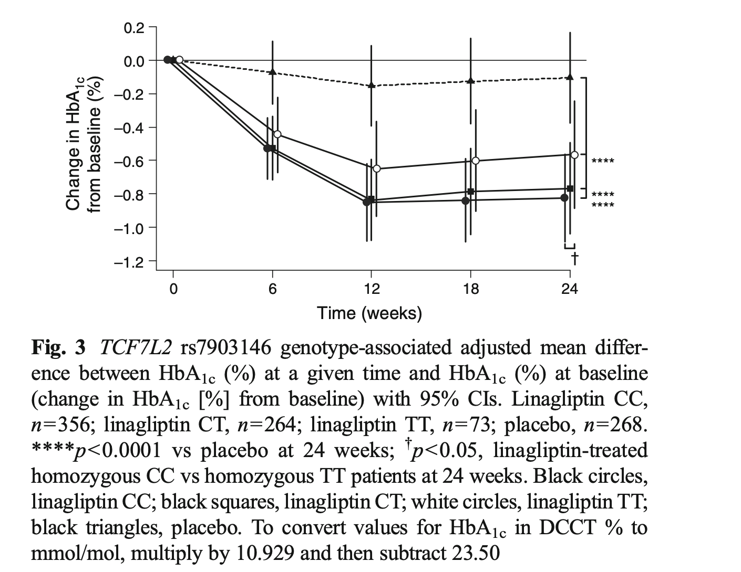
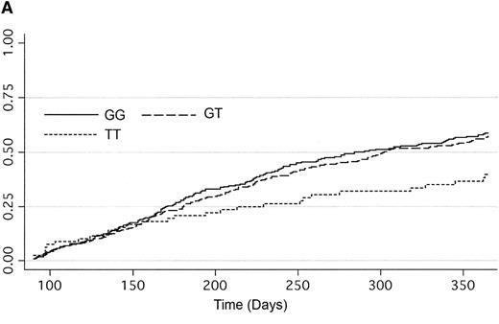
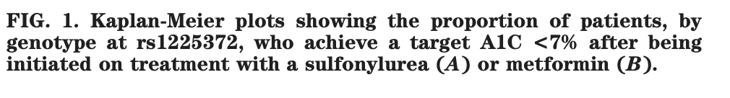
Variants in TCF7L2 and pharmacogenetics
Carriers of the risk T-allele were less likely to respond to sulfonylureas with an odds ratio (OR) for failure of 1.95 (P=0.005), comparing rs12255372 T/T vs. G/G
Carriers of the TT genotypes were less likely to respond to linagliptin comparing to C/T vs. C/C
Placebo
TT
CT/CC
Pearson et.al. Diabetes 2007
Zimdahl et.al. Diabetologia 2013

Slide 26
TCF7L2
TCF7L2 variants demonstrate multiple mechanisms involved in insulin secretion and synthesis, hepatic glucose production, incretin action, body mass index, fasting and postprandial glucose levels as well as multiple diabetes co-morbidities (retinopathy, kidney disease, neuropathy, depression etc).
Precise mode of action of the TCF7L2 risk allele is still unknown, however, might involve open chromatin modifications.
TCF7L2 variants influence therapeutic response to therapies targeting beta-cell function such as sulfonylureas and incretin modalities but not metformin.

Slide 27


MTNR1B
MTNR1B
Melatonin
Stress hormons
12:00 PM
12:00 AM
9:00 PM
3:00 AM
40
40
30
30
20
20
15
15
10
10
5
5
6:00 AM
6:00 PM
6:00 AM
Notes:
Before you are falling asleep at the end of this long day, let us in the following discuss a gene which influences our circadian clocks, the melatonin receptor 1b.
Melatonin is a circulating hormone which has primarily been implicated in the regulation of circadian rhythms, and circulating levels of the hormone are low during the day and high during night.

Slide 28
MTNR1B
Melatonion
Stress hormons
12:00 PM
12:00 AM
9:00 PM
3:00 AM
40
40
Physical
repair
30
30
20
20
15
Wind - Down
Dim - Lights
Psychological
repair
15
10
10
5
5
6:00 AM
6:00 PM
6:00 AM
Boden et al. Evidence for a circadian rhythm of insulin secretion.
Am. J. Physiol. 1996, 271:246–252.
Rising Star Symposium EASD, Vienna, 2009
Notes:
and high during the night. In fact, it has been proposed that melatonin could be involved in a circadian lowering of nocturnal insulin levels.

Slide 29
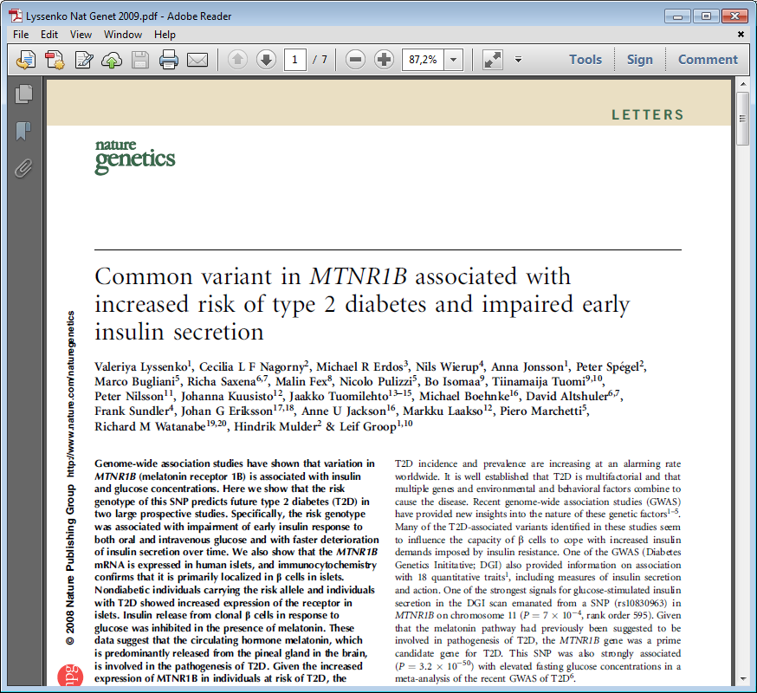

Variants in the melatonin receptor 1 B (MTNR1B) influence insulin secretion and risk for T2D
Decreased insulin secretion
PPP, n∼5000
MTNR1B expression is increased in pancreatic islets
Melatonin inhibits glucose-stimulated insulin secretion
Human Tissue Lab
NIH cadaveric donors
INS1 cells
Lyssenko et al. Nat Genet, 2009.

Slide 30
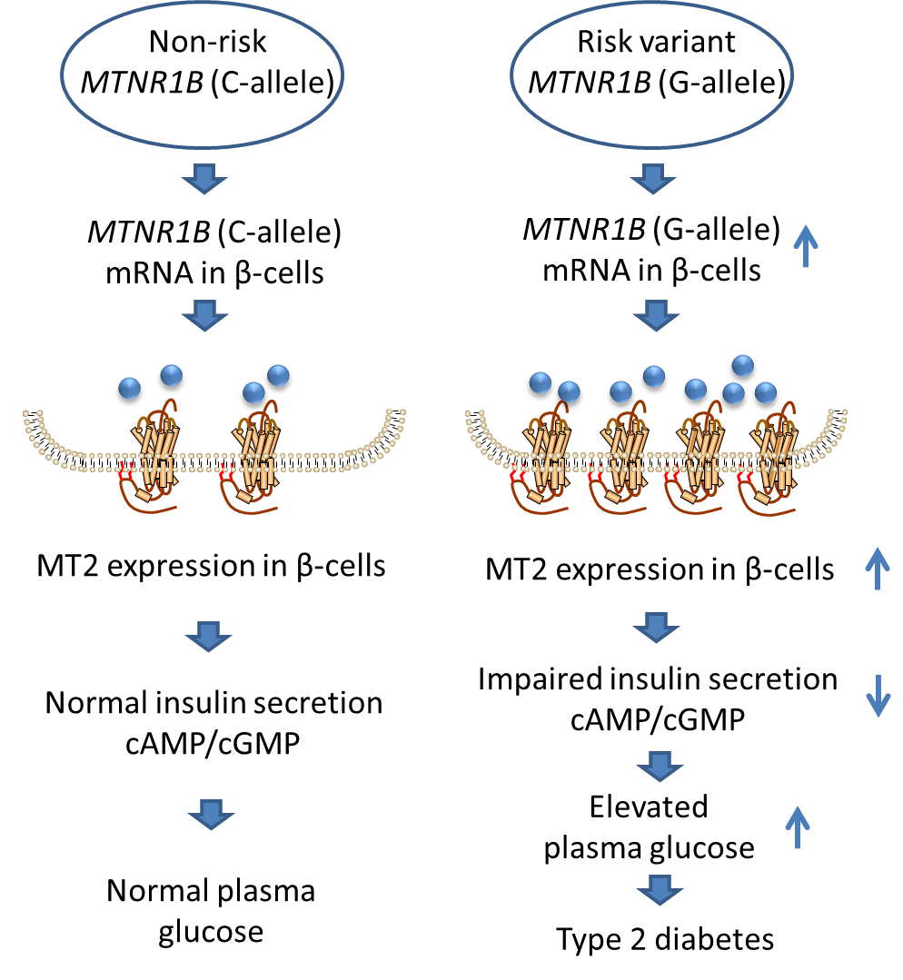
Pathogenic mechanisms
Mulder et al, Diabetologia, 2009

Slide 31
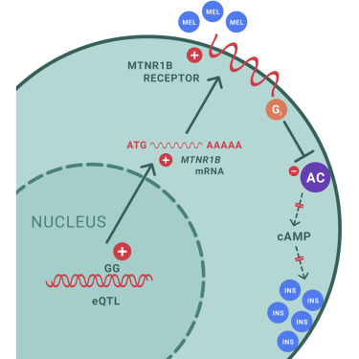
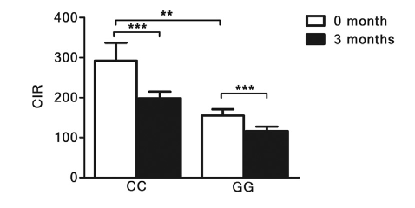
Existing examples of RbGsv
Melatonin receptor and type 2 diabetes
common variant in MTNR1B associated with T2D (Lyssenko et.al, Nat Genet 2009, Prokopenko et.al, Nat Genet 2009)
G-allele associated with impaired insulin secretion via increased expression in islets (Lyssenko et.al, Nat Genet, 2009)
23 GG and 22 CC genotype carries of MTNR1B were administered melatonin at night for 3 months (Tuomi, Cell Metabolism 2016)
Risk GG carriers inhibited increased glucose and reduced insulin secretion (Tuomi, Cell Metabolism 2016)

Slide 32
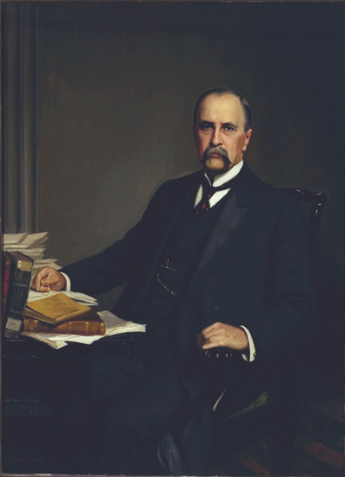
Knowledge on different disease conditions is prerequisite for personalized medicine
The good physician treats the disease; the great physician treats the patient
who has the disease
Sir William Osler (1849-1919)

Slide 33
Take home message: effects of T2D genes
Beta-cell function
Apoptosis/proliferation of β-cells
Incretin action, nutrient partitioning
Islet response to stress hormones
Inflammation-induced insulin resistance
Circadian rhythm
Developmental programming may underly these defects

Slide 34
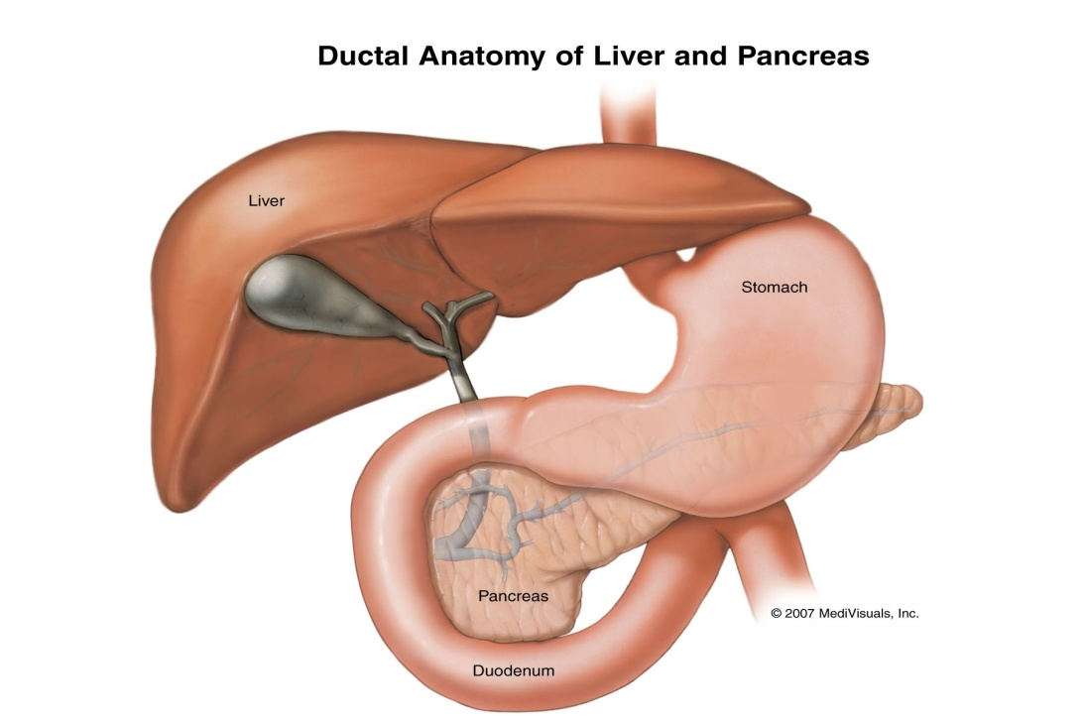
Many T2D genes influence the enteroinsular axis and islet function
MTNR1B
TCF7L2
ADRA2
GIPR

Slide 35
CONCLUSIONS
Impaired beta-cell function is a key mechanism in the pathogenesis of type 2 diabetes and its assessment should be implemented in the clinical practice.
Human genetics is a powerful and unbiased approach to identify novel and prove established mechanisms in the pathogenesis of type 2 diabetes.
Genetic factors governing developmental programming of metabolic diseases may underly multiple organ dysfunctions in type 2 diabetes.
Genetics studies on diabetes complications might aid understanding into molecular defects attributed to glucose and non-glucose related factors to improve prediction of progression and choice of therapy – an important step forward precision medicine in diabetes.

Slide 36


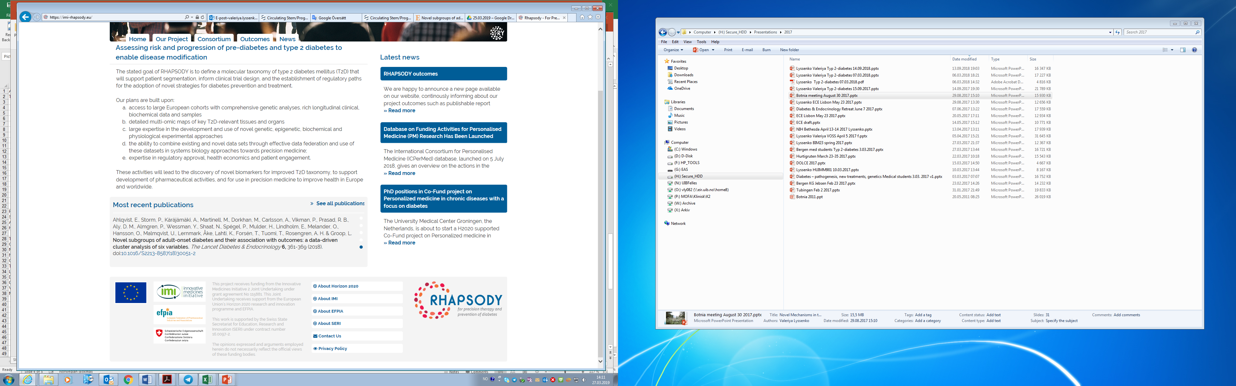


ACKNOWLEDGEMENTS
University of Bergen
Lund University
Pål Njølstad
Olena Fedotkina
Turkuler Ozgumus
Magdalena Keindle
Elsa du Plessis
Ruchi Jain
Mikael Åkerlund
Olof Aspund
Rashmi Prasad
Peter Almgren
Helena Mattisson
Theodosia Massadakis
Garbriella Gremsperger
Isabella Artner
Corrado Cilio
Jeanette Arvastsson
Emma Ahlqvist
Mattias Borell
Johan Hultman
Peter Spegel
Peter Nilsson
Tiinamaija Tuomi
Leif Groop
DOLCE study
Steno Diabetes Center Copenhagen
Liubov Cherviakova
Nadiya Khalimon
Tetiana Svietleisha
Tetiana Buldenko
Allan Vaag
Troels Jensen
Catherine Moller
Lars Diaz
University of Pisa
Ele Ferrannini

Slide 37
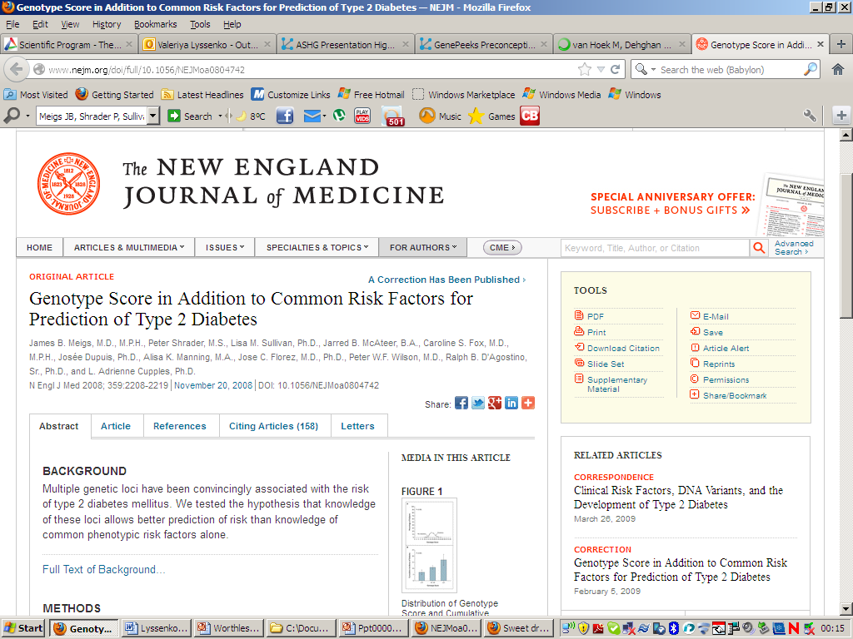
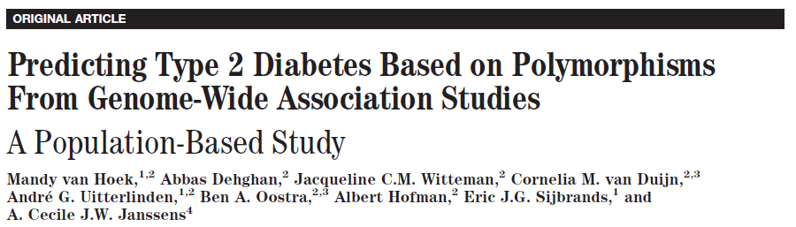




Genes to predict type 2 diabetes?

Slide 38
Type 2 diabetes risk loci have modest discrimination ability
1.0
Perfect test:
AUC = 1
0.8
Useful clinical test:
AUC ~ 0.8-0.9
0.6
As by random: Area under the curve (AUC) = 0.5
True positive rate (Sensitivity)
0.4
37 genetic variants:
AUC = 0.64
0.2
0.0
0.0
0.2
0.4
0.6
0.8
1.0
False positive rate (1-Specificity)

Slide 39
Genetic factors predicted better future type 2 diabetes the earlier in life they were tested
Genetic risk factors modestly improve the prediction of diabetes as compared to clinical factors alone (P=0.0001)
Clinical model
N=16
Genetic model
AUC = 0.754
AUC = 0.674
AUC = 0.565
AUC = 0.623
p=0.01
p=0.01
Lowest quintile
Lowest quintile
Highest quintile
Highest quintile
Lyssenko et al, New Engl J Med 2008.

Slide 40



Slide 41
Metformin inhibits gluconeogenesis in hepatocytes

Slide 42

Variants in the organic cation transporter 1 (OCT1) influence effectiveness of metformin
Risk alleles at OCT1 increase the incidence of gastrointestinal effects
Shu et. Al, JCI, 2007

Slide 43



GWAS identifies variants in the ATM rs11212617 to be associated with metformin effect on HbA1c
Nature Genetics 2011

Slide 44
Absorbtion and elimination of metformin the relevant tissues
Florez, Diabetologia 2017

